Slide 1




Thorat Yash Sachin Prn No:- 12220255 Class: -B-tech
Vishwakarma Institute of Technology, Pune
Hydraulic Cylinder
Guide:-
Prof .V . Deshpnde

Slide 2
Agenda
About Company
Introduction
Primary goals
Literature Review
Methodology
About Company
Introduction
Primary goals
Literature Review
Methodology
Calculation
References

Slide 3
About Company
Company Name: - JEKUMA TOOLS AND GAUGES PVT LTD
Jekuma Tools And Gauges Pvt Ltd is a Private incorporated on 01 August 1983. It is classified as a non-govt company and is registered at Registrar of Companies, Pune.
Its authorized share capital is Rs. 30,000,000 and its paid-up capital is Rs. 30,000,000. It is involved in Extra Territorial Organizations and Bodies.

Slide 4
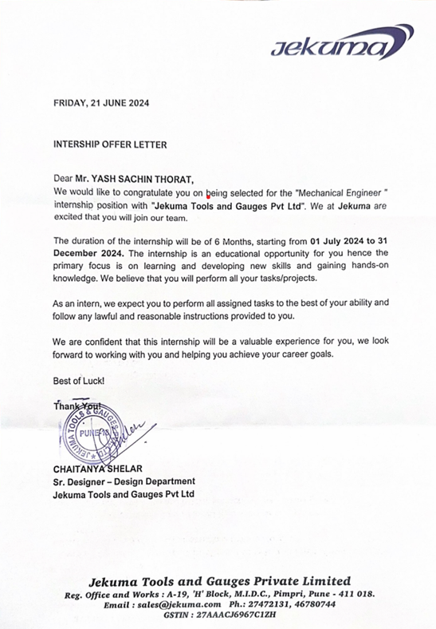
Introduction to Hydraulic Cylinders Key Component A hydraulic cylinder is a crucial part of a hydraulic press, responsible for generating the force needed for pressing operations. Energy Conversion It converts fluid energy into linear mechanical force and motion, acting as a positive displacement reciprocating hydraulic motor. Types Hydraulic cylinders are broadly classified into single-action and double-action cylinders.

Slide 5

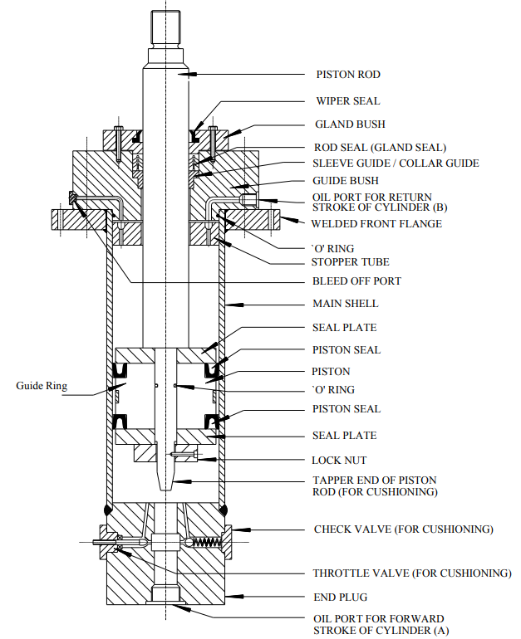
“QUOTE”
1.Piston Rod
2. Wiper Seal
3. Gland-Bush
4. Rod Seals
5. Removable Guide Bush
6. End-Plug
7. Oil Port
8. Cylinder-Tube-Flanges
9. 'O' Ring
10. Stopper Tube
11. Air-Bleed-Off-Port
12. Main Shell
13. Seal Plates1
4. Piston Seal
15. Piston
16. Lock Nut
17. Guide-Ring
18. Cushioning

Slide 6
Literature Review
1] Improving the design of hydraulic cylinders used in hydraulic equipment for irrigation and drainage(2020) Recent advances in hydraulic system design, particularly for agricultural machinery, have focused on enhancing the reliability and efficiency of hydraulic cylinders. Innovative sealing mechanisms, such as those using permanent magnets, have been developed to improve load distribution, leading to greater seal durability and overall system reliability.
2] Study of Manufacturing of Hydraulic Cylinder Rod(2020) The manufacturing of hydraulic cylinder rods is a detailed process, crucial for ensuring the durability and performance of these components in industrial and agricultural machinery. Starting with the selection of C45 steel for its strength, the process involves heat treatment to enhance hardness, followed by straightening for proper alignment.
3] Design and Analysis of Piston Rod Joint in Hydraulic Cylinder for Industrial Implements(2017) The design of piston-rod joints in hydraulic cylinders is crucial for ensuring their performance in heavy industrial applications, where they must endure significant tensile loads and preload conditions. Research has explored various joint configurations to identify the most effective design for these demanding environments.
4] Design and Realization of Hydraulic Cylinder(2017) The paper provides an overview of hydraulic cylinders, including their components, design considerations, and applications in various industries. Hydraulic technology is widely used in various industries for mechanical transmission and control. - Hydraulic cylinders can be classified into different types based on their action and structure.
5] Design And Analysis Of Hydraulic Cylinder Using Ductile Cast Iron(2021) The Paper Present the Selecting the right material for hydraulic cylinders in heavy machinery, such as JCB equipment, is crucial for optimizing cost, strength, and durability. Recent research highlights ductile cast iron 60-4018 as a superior alternative to stainless steel 304.

Slide 7
References
1] Yevgeniy Slivinskiy1 , Sergey Radin (2020), “Improving the design of hydraulic cylinders used in hydraulic equipment for irrigation and drainage” E3S Web of Conferences 175, 05012.
2] H A J Sadiq Sha (2020) “Study of Manufacturing of Hydraulic Cylinder Rod” International Research Journal of Engineering and Technology (IRJET) e-ISSN: 2395-0056 Volume: 07 Issue: 06.
3] M. Antony Maria Thomas Benny1 , U.S. Chavan (2017). “Design and Analysis of Piston Rod Joint in Hydraulic Cylinder for Industrial Implements”. IOSR Journal of Mechanical and Civil Engineering (IOSR-JMCE) e-ISSN: 2278-1684,p-ISSN: 2320-334X, Volume 14, Issue 3 Ver. VII.
4] Puqing Luo, Jianzhong Hu, Shijun Tan (2017), “Design and Realization of Hydraulic Cylinder”, School of Mechanical Engineering, Yueyang University of Technology, Hunan, China. Water Conservancy.
5] G. Senthil Kumar1, Mariya Sunil Joshi.A2, Narendran.K 3, Raveendar. V (2021), “Design And Analysis Of Hydraulic Cylinder Using Ductile Cast Iron” International Research Journal of Engineering and Technology (IRJET) e-ISSN: 2395-0056 Volume: 08 Issue: 03

